Slide 1
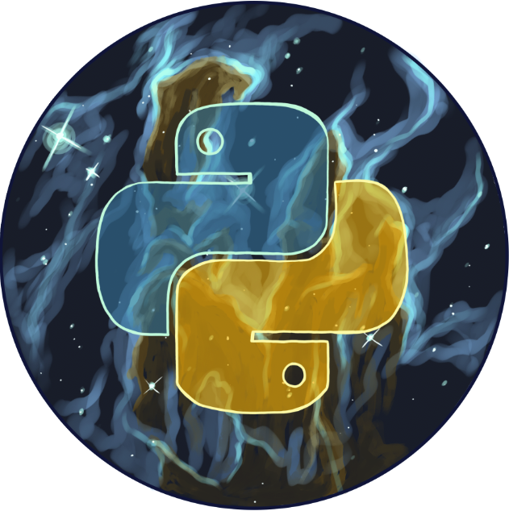

Welcome to the
Python DeCal!
Review Session + Documentation
[Class 21] November 12th, 2025

Slide 2
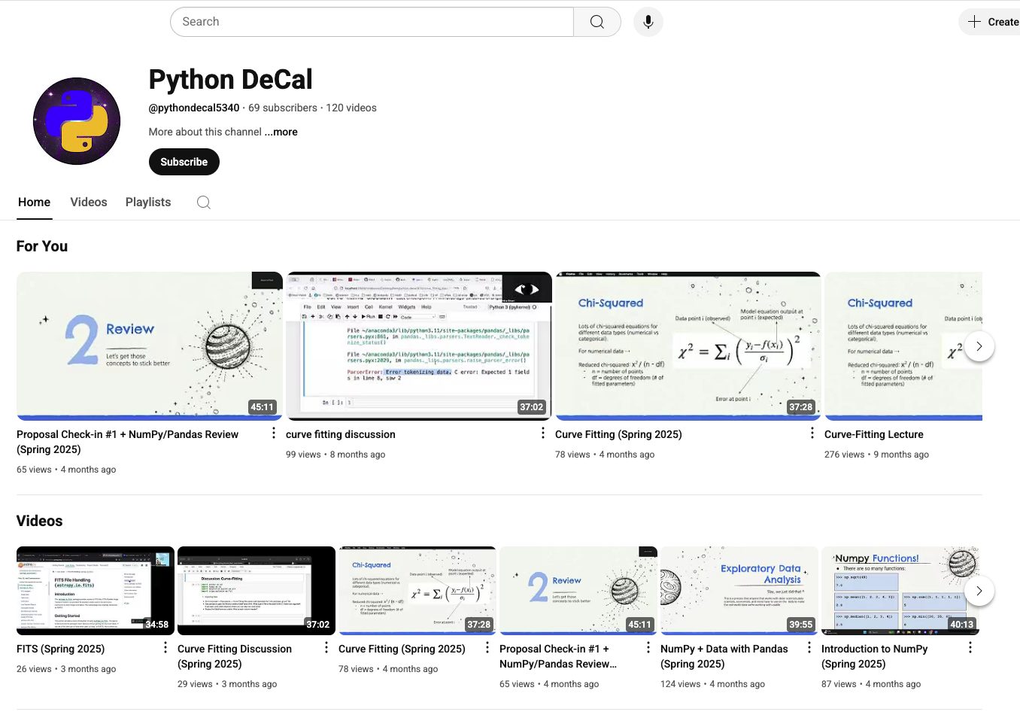
Lectures will be Recorded
This class will be recorded and posted to our YouTube Channel!
Subscribe :)

Slide 3
Overview for today!
Announcements
Warm-up
Documentation Lecture
Review Session
Lecture Engagement

Slide 4
01
Announcements
:) :) :) :) :) :) :) :) :) :) :) :)

Slide 5
Announcements
-[Late] Homework 8 is due tonight, Nov. 12 @ 11:59 pm
-Homework 10 is due tonight, Nov. 12 @ 11:59 pm
-Homework 11 will be released soon!
-due next Wednesday, Nov. 19 @ 11:59 pm
~3 weeks until Final Project Presentations!

Slide 6
02
Warm-Up
Let’s do a little review

Slide 7
Warm-up questions
Please write your answers on a piece of paper
What is good coding etiquette?
What is AstroPy?
What are three useful unit conversions / constants from AstroPy?
What is the command to open a FITS file?

Slide 8
Warm-up questions Answers
Use of descriptive variables, comments explaining lines of code, function descriptions
Compilation of packages and functions specifically helpful for astrophysics calculations and data analysis
There are many! Here are a few honorable mentions:
  [variable].to(units.au)
  [variable].value
  print(const.c)
fits.open(“insert_file_name.fits”)

Slide 9
03
Documentation Lecture

Slide 10
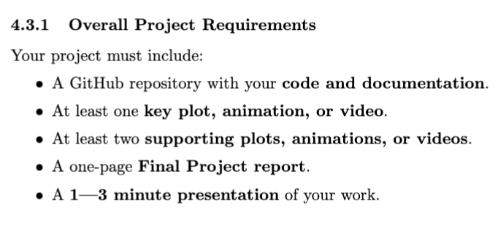
Documentation
Important note:
Required for the Final Project!
What is documentation?
Turns your code from usable only by you to understandable by everyone!
It helps you (and future programmers) remember what your code does, why it exists and how to use it.

Slide 11
Documentation
Three Levels of Documentation:
Inline Comments
  Short explanations inside your code that clarify logic or reasoning
  Good comments explain “why”, not “what” the code is
Docstrings
  A special triple-quoted string placed at the start of a function, class (we haven’t learned what this is yet but stay tuned for OOP!), or module.
  It describes what the function does, what the parameters mean, and what it returns

Slide 12
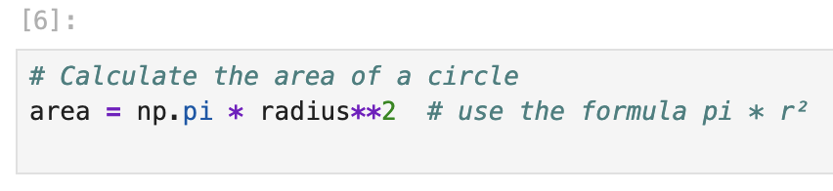
Documentation
Examples of Type 1 documentation:

Slide 13
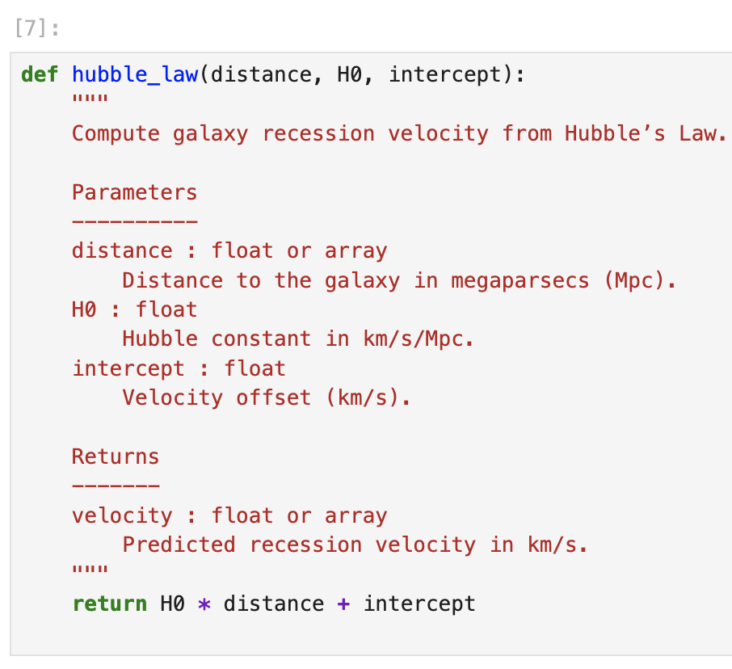
Documentation
Examples of Type 2 documentation:

Slide 14
Documentation
Three Levels of Documentation:
3) README or Project Notes
Every project should have a short README.md (in Markdown) explaining:
  What the project is
  How to install dependencies (if needed)
  How to run code
  Example usage

Slide 15
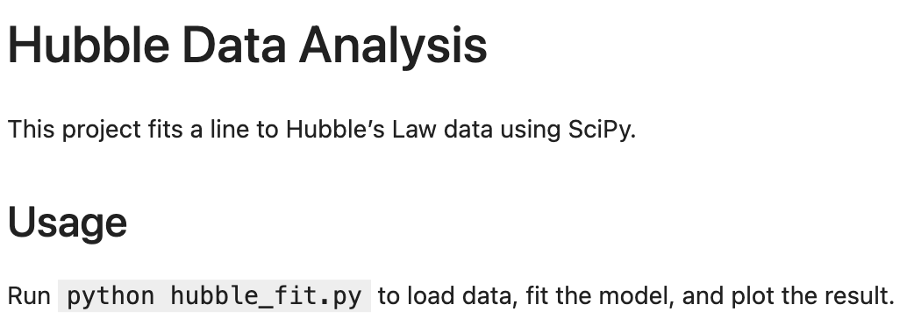
Documentation
Examples of Type 3 documentation:

Slide 16
Documentation
Key Takeaways:
Write documentation as you code, not afterward.
Use clear, plain language.
  Your audience may not know your shortcuts.
Keep it up to date when your code changes.
Be consistent in your style and tone

Slide 17
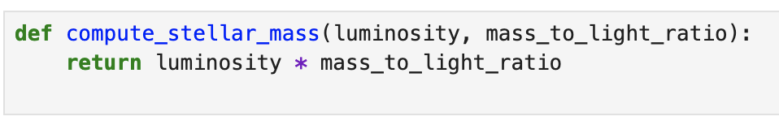
Practice Question
Inline Comments
Add clear comments to this function explaining what each line does and why:
What kind of comment would not be helpful here?

Slide 18
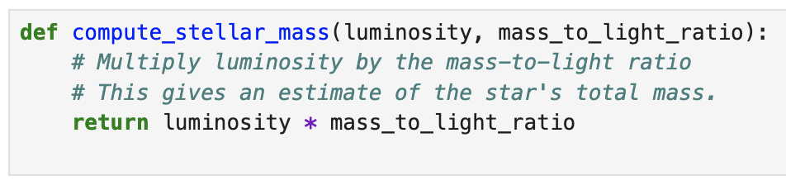
Practice Question Solutions
Example solution:
Unhelpful comment:
“Multiplies two numbers together”
This comment is explaining what the code does, not why.
Good comments should have a purpose.

Slide 19
Practice Question
With the person next to you, discuss the following:
Have you started your Final Project?
What is your Final Project?
Have you added documentation to your code?
  If not, how can you add documentation?
  If yes, how can you improve your documentation.

Slide 20
04
Review Session
:)))))

Slide 21
Review: Astropy!
Recall: Astropy
Astropy = core Python library for astronomy
Provides tools that solve problems for astronomers! Like:
  Attaching units to values
  Constants (Planck’s constant, Gravitational constant, etc.)
  Coordinate and positions (we didn’t cover this in class)
    Right ascension & declination, galactic coordinates
  FITS files
    FITS file = standard data format for telescopes

Slide 22
Recall: FITS Files
Recall: FITS files
FITS (Flexible Image Transport System) = standard data format used by nearly all astronomical observatories, like:
  Hubble, JWST, Keck, ALMA, LSST, IRTF, etc!
A FITS file usually contains:
  Header = metadata (exposure time, telescope, filter, etc)
  Data = the image itself (2D array), tables, or binary data
Astropy makes working with FITS files easier
  fits.open() = load a FITS file
  .header = access image metadata
  .data = get the pixel array

Slide 23
Practice Question
Let’s work with some real data!
This data comes from the Leuschner telescope in Lafayette!
It was taken by Brianna when she took ASTRON 120 lab during Fall of 2024
Steps:
Open a Jupyter Notebook.
Import necessary packages (numpy, astropy, etc.)
Download the “stars.fits” file from Courses.
Use astropy to open the FITS file
  Assign the header to a variable called header
  Assign the data to a variable called data

Slide 24
Practice Question
Use Astropy to figure out the following about the file:
  Print the header.
  What are the dimensions of the file?
    Hint: What are the sizes of rows and columns of the image?
  What was the exposure time in seconds?
Plotting the image:
  Plot the image “normally” (i.e., no image processing)
  Plot the image without outliers
    Hint: Use vmin and vmax.
  Plot the image on a logarithmic scale.
  What do you notice about the different scales?

Slide 25
Practice Question
Bonus: Use starfinder to count how many stars are in the image!
Research the package photutils
  Use sigma_clipped_stats
  Use DAOStarFinder
  Use daofind
You should find about 23 stars!

Slide 26
05
Lecture Engagement
Show us what you know!

Slide 27
Lecture Engagement
Fill out the engagement assignment on Gradescope!
Always due before next class.
Takes 1-5 minutes to complete.

